Slide 1
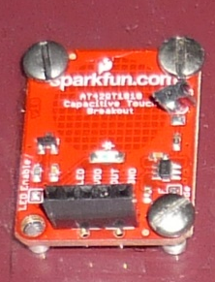
Ponce, Genecin, Perez and Livingstone (2016) – SUPPLEMENTARY INFORMATION
How we put together our Arduino portable system:
We first programmed the Arduino and confirmed that all sensors behaved as expected.
We made holes in our monkey chairs to fit the sensors.
We built a portable rig using 80/20 Erector set (https://www.8020.net/)
We assembled the reward circuit and made sure that water flowed at our preferred levels.
Arduino Uno
HC-SR04 ultrasonic range detectors
Aluminium touch bar (in chair)
AT42QT1010 capacitative touch sensor
Water reservoir (different view)
20-V solenoid valve circuit and water reservoir

Slide 2
Arduino and sensors. After downloading the Arduino program, practice using sample scripts (File→Scripts). We started with “Blink,” copied below. Feel free to review our code (included in this Github repository).
/*
Blink
Turns on an LED on for one second, then off for one second, repeatedly.
Most Arduinos have an on-board LED you can control. On the Uno and
Leonardo, it is attached to digital pin 13. If you're unsure what
pin the on-board LED is connected to on your Arduino model, check
the documentation at http://arduino.cc
This example code is in the public domain.
modified 8 May 2014
by Scott Fitzgerald
*/
// the setup function runs once when you press reset or power the board
void setup() {
// initialize digital pin 13 as an output.
pinMode(13, OUTPUT);
}
// the loop function runs over and over again forever
void loop() {
digitalWrite(13, HIGH); // turn the LED on (HIGH is the voltage level)
delay(1000); // wait for a second
digitalWrite(13, LOW); // turn the LED off by making the voltage LOW
delay(1000); // wait for a second
}

Slide 3
2. Prepare the chair for the sensors.
Touch bar in acrylic base: can be fixed to cage or chair
HC-SR04 ultrasonic range detectors
Front of chair

Slide 4
Chair with lixit, touch bar and proximity sensors in place

Slide 5
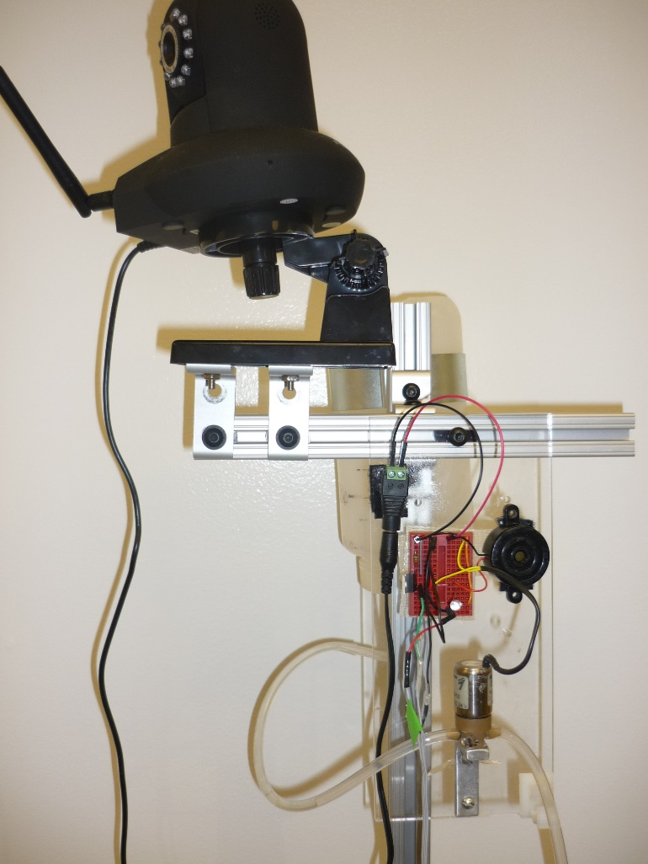
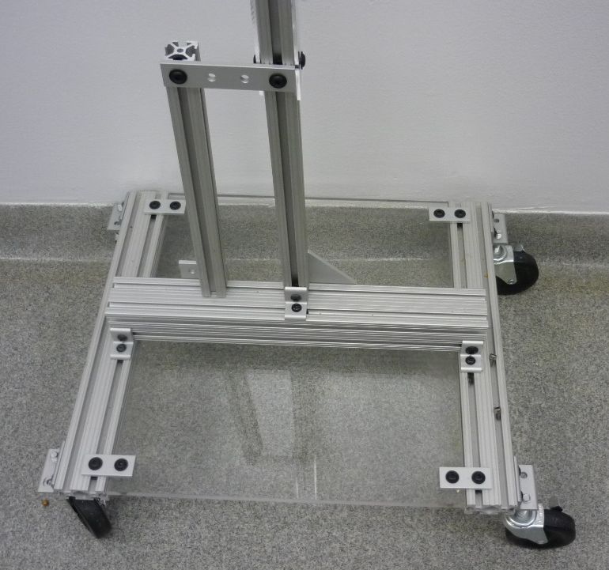
3. Portable rig. We used 80/20 erector set parts to put together a portable rig (https://www.8020.net/). This can be used to hold the water bottle, reward circuit, laptop and camera. The design is guided by personal preferences.

Slide 6
3. Reward circuit. The Arduino and its sensors can be powered by a 5-V source, but the solenoid valve requires a higher voltage (24-V). Thus we built a peripheral circuit that could be activated by the Arduino reward signal pin. The circuit used a MOSFET gate, which conducted current through the solenoid when its 5-V gate was activated by the Arduino output.

Slide 7
24-V power input
Reward buzzer
MOSFET (gate)
Voltage divider
Solenoid/valve

Slide 8
Final setup

Slide 9
Starter kit
Electronics |  | Approximate cost per unit (USD)
Arduino Uno | http://store-usa.arduino.cc/ | 30
Capacitive touch sensor (AT42QT1010) | www.sparkfun.com | 5-10
Ultrasonic range detectors (HC-SR04) | www.sunfounder.com | 5-10
Breadboards, jumpers | www.sparkfun.com
Microtivity IL611 5mm Diffused RGB Controllable LED, Common Cathode (Pack of 12) | www.amazon.com | 6
SYB-170 Color Board Mini Small Bread Board | www.amazon.com | 9
Power Adapter for Arduino AC to DC 9V | www.amazon.com | 6
Microtivity IB400 400-point Experiment Breadboard | www.amazon.com | 5
Solderless Flexible Breadboard Jumper Wires | www.amazon.com | 7
Portable rig
Aluminum T-Slotted Framing Extrusion, Single Profile, 1" Size, Solid | http://www.mcmaster.com/ | 32
Reusable Nylon Cable Tie Squeeze Release, 8" Long, 2" Max Bundle Dia, Black | http://www.mcmaster.com/ | 7
Clamping Hanger Galvanized STL W/Bolt & Nut, 3-1/2" ID, 160 lb Cap. | http://www.mcmaster.com/ | 8
Threaded-Stem Swivel Caster W/Brake, 3/8"-16 Stem, 3" X 13/16" Rubber Whl, 125#Cap | http://www.mcmaster.com/ | 11
Aluminum T-Slotted Framing Extrusion 90 Degree Bracket | http://www.mcmaster.com/ | 4
Aluminum T-Slotted Framing Extrusion 90 Degree Plate | http://www.mcmaster.com/ | 7
Compact End-Feed Fastener, 1/4"-20 Thread for Aluminum T-Slotted Framing Extrusion | http://www.mcmaster.com/ | 2
Aluminum T-Slotted Framing Extrusion 90 Degree Bracket, Sngl, 2-Hole, for 1-1/2" Extrusion | http://www.mcmaster.com/ | 4
VWR BOTTLE RED CAP 1000ML (16650-322) | www.vwr.com | 7
Reward circuit
Two-way solenoid valve (3-111-900, VAC 50PSIG) | www.parker.com | 10
Voltage regulator (497-15681-5-ND) | www.digikey.com | 0.6
Gate (FET) transistor (FQP30N06L-ND) | www.digikey.com | 1
AC/DC mount adapter 24-V (T1073-P5P-ND) | www.digikey.com | 14

